Slide 1
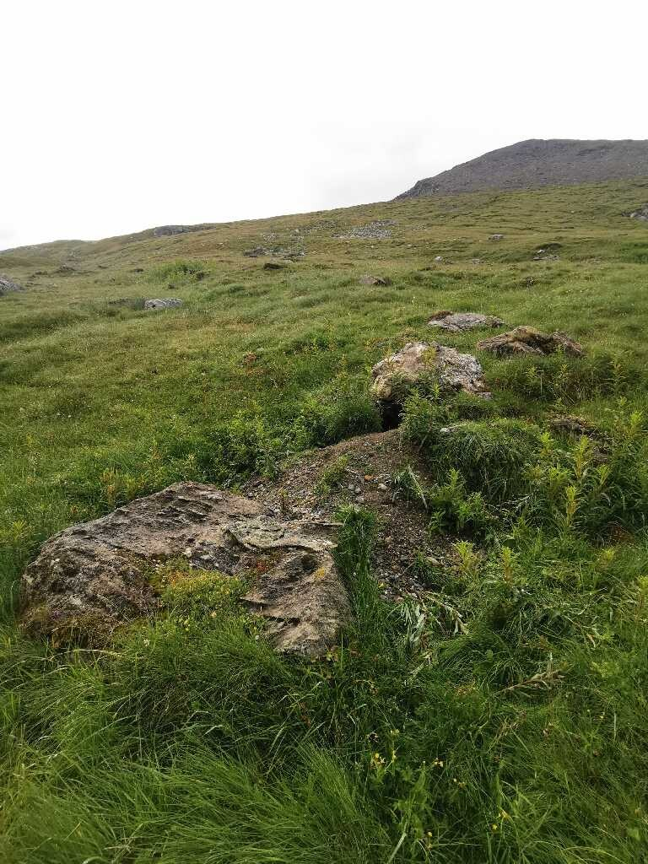
Terriers marmottons 2025
B3

Slide 2
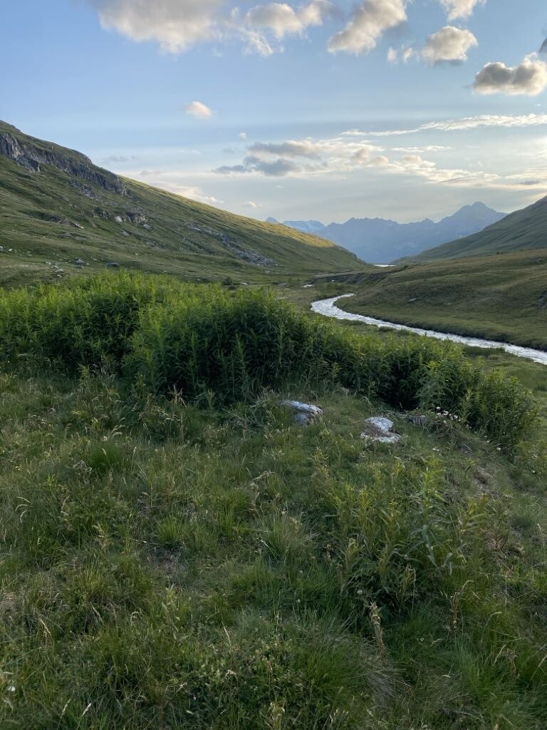
Terriers marmottons 2025
B2

Slide 3
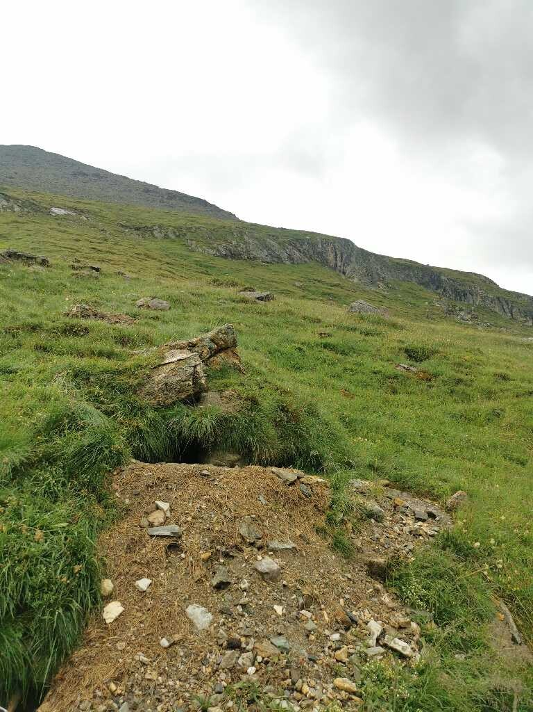
Terriers marmottons 2025
R

Slide 4
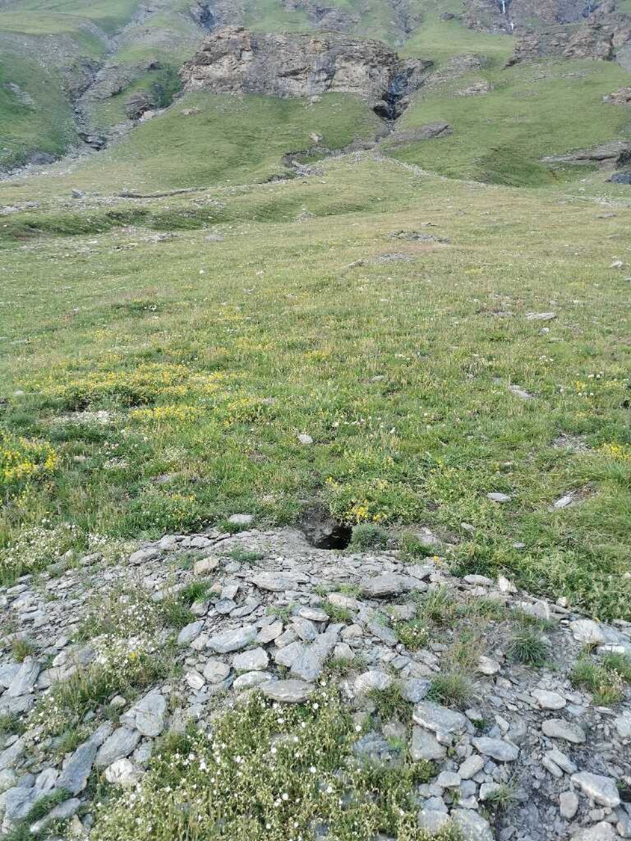
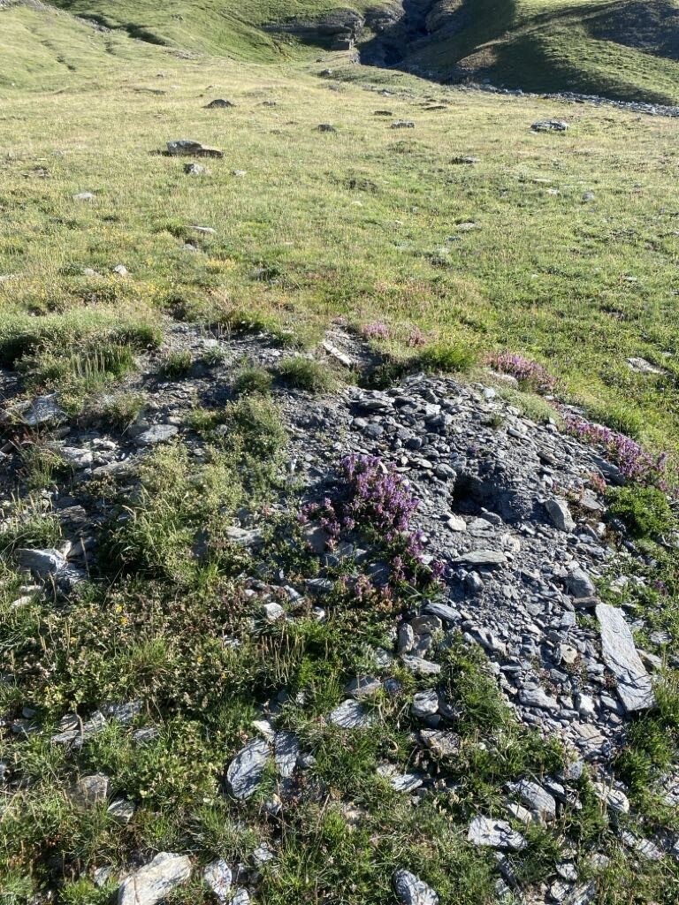
Terriers marmottons 2025
T
(1er terrier)

Slide 5
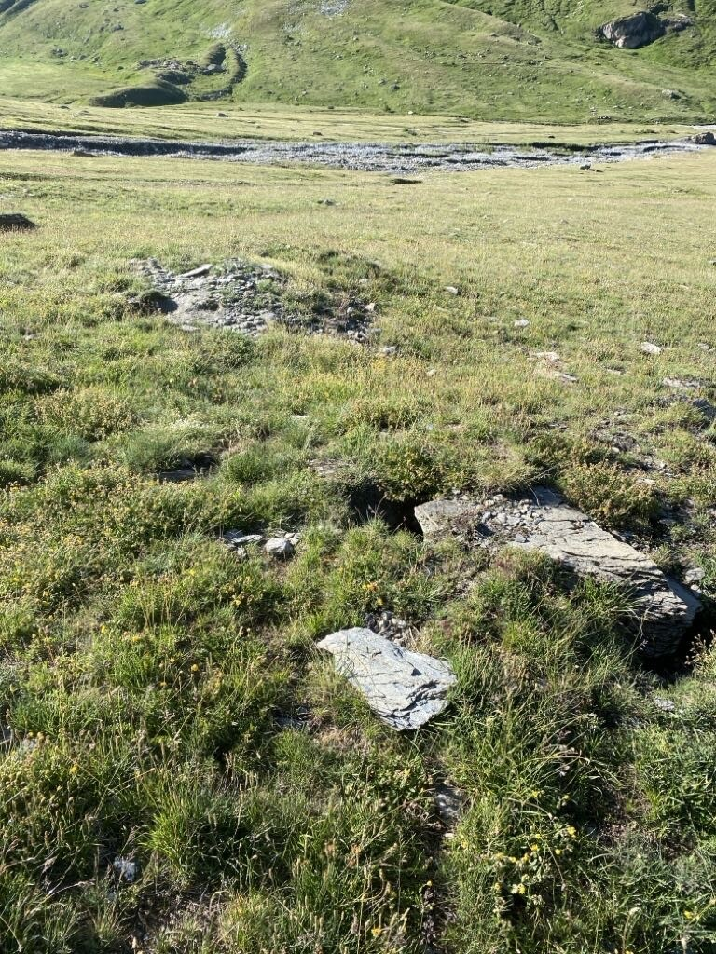
Terriers marmottons 2025
T
(2eme terrier)

Slide 6
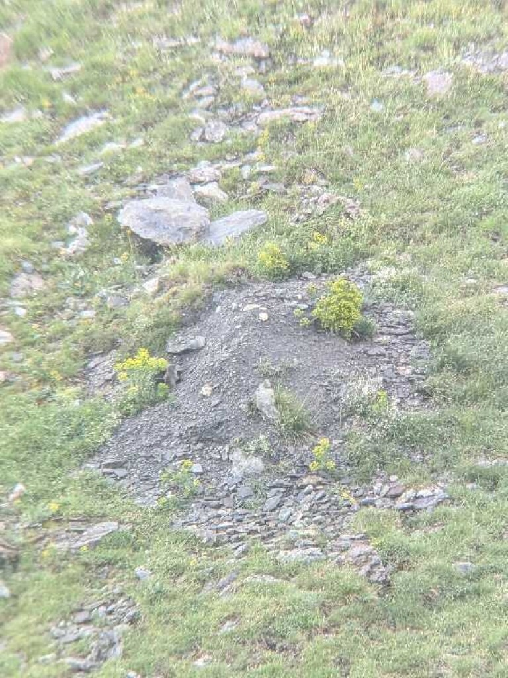
Terriers marmottons 2025
W

Slide 7
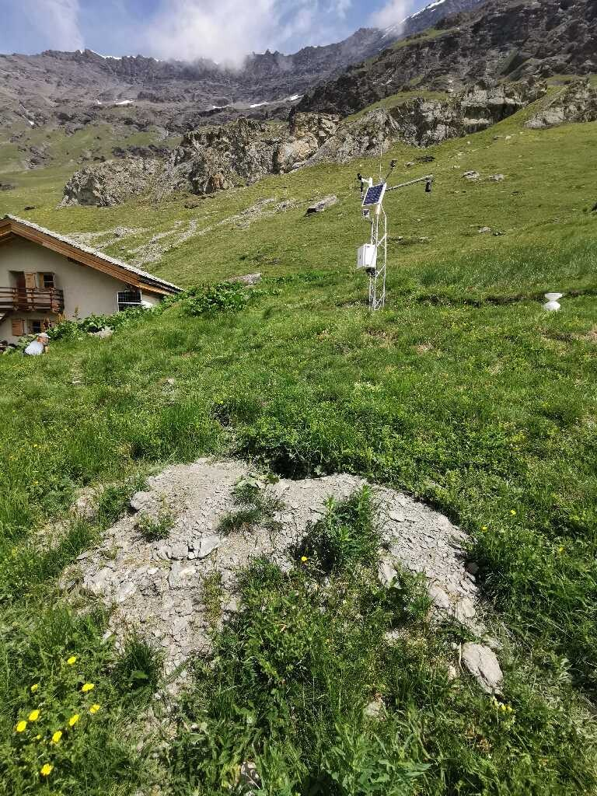
Terriers marmottons 2025
Chalet bas
(1er terrier)

Slide 8
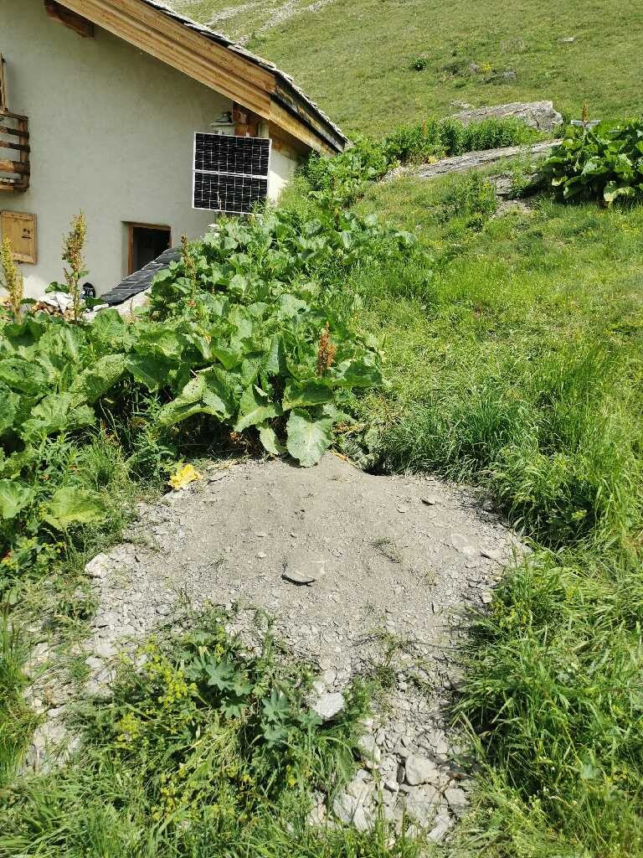
Terriers marmottons 2025
Chalet bas
(2eme terrier)

Slide 9
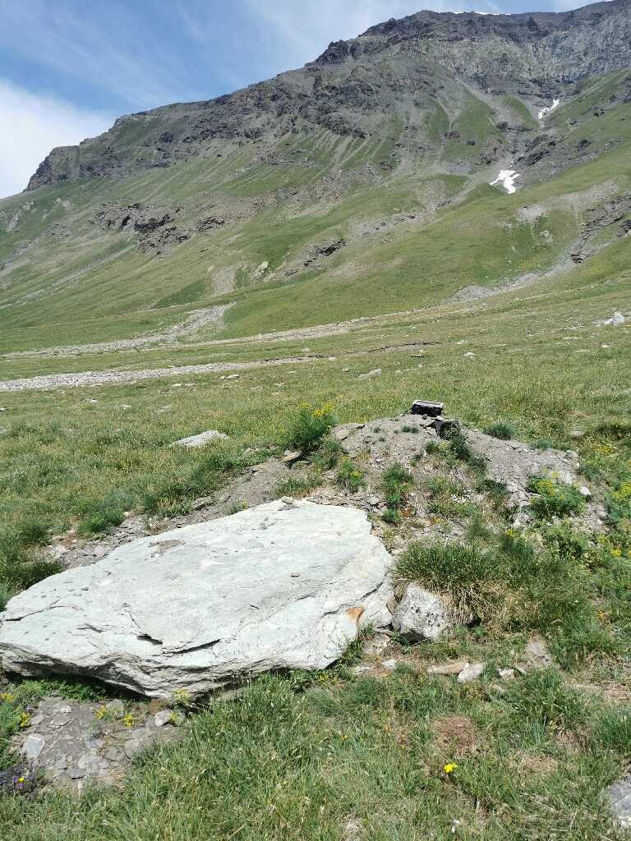
Terriers marmottons 2025
N

Slide 10
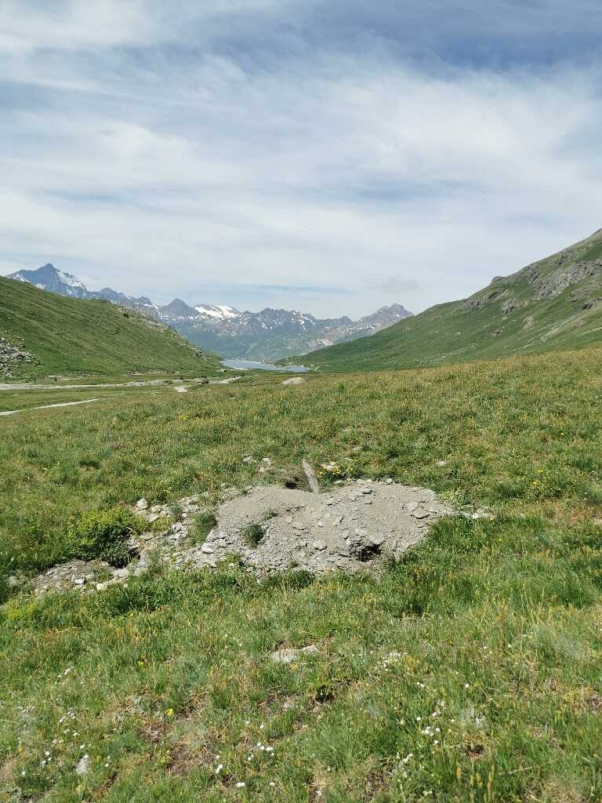
Terriers marmottons 2025
N3

Slide 11
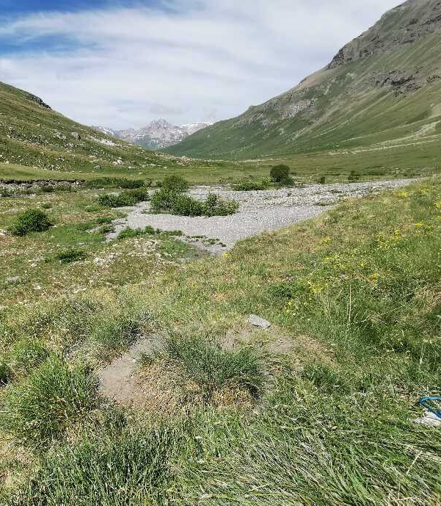
Terriers marmottons 2025
Z

Slide 12
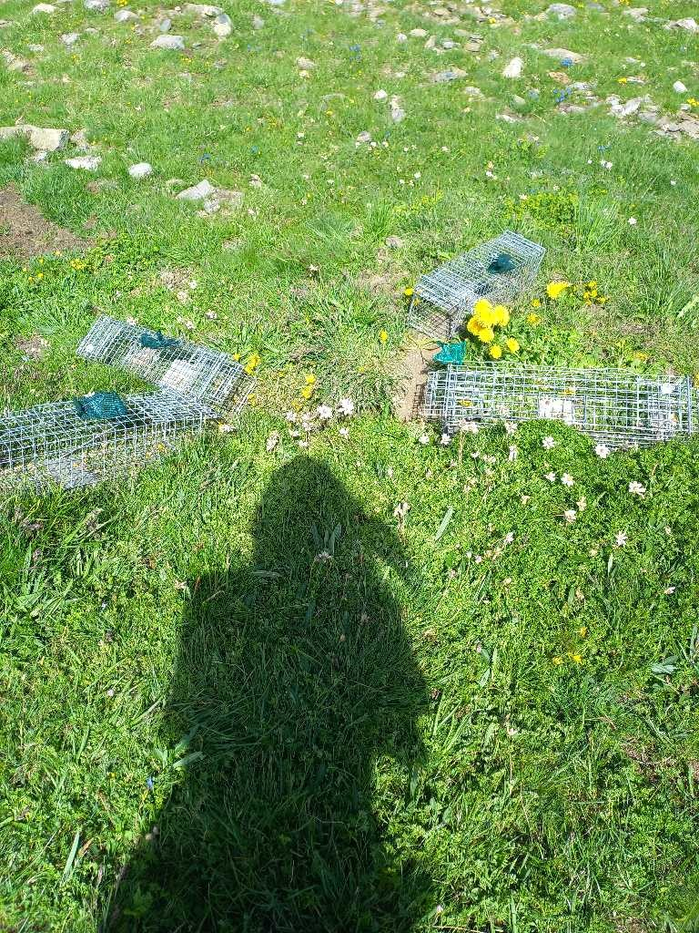
Terriers marmottons 2024
J

Slide 13
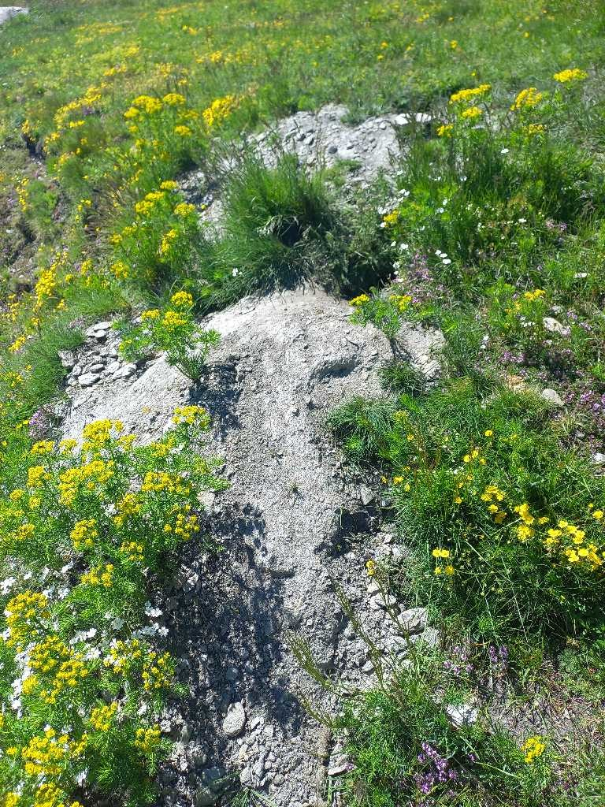
Terriers marmottons 2024
E

Slide 14
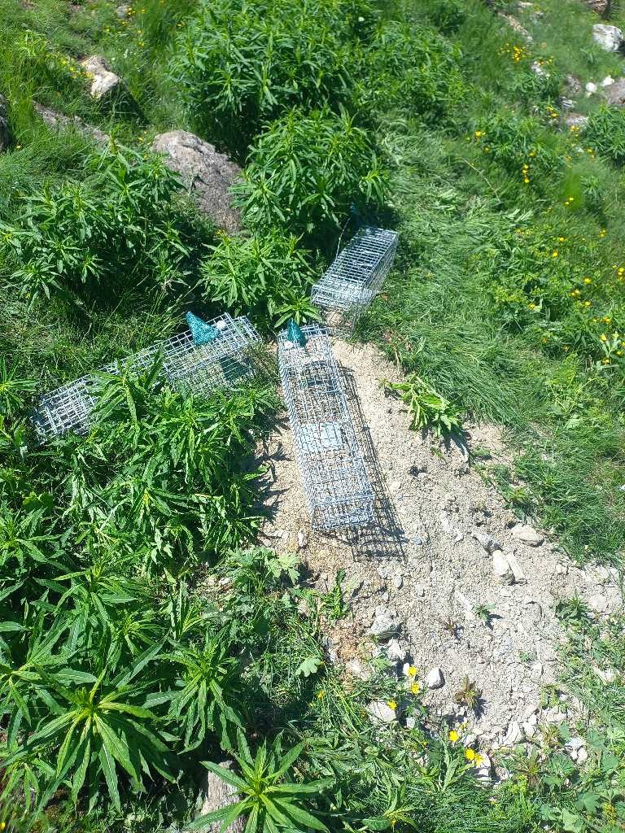
Terriers marmottons 2024
B

Slide 15
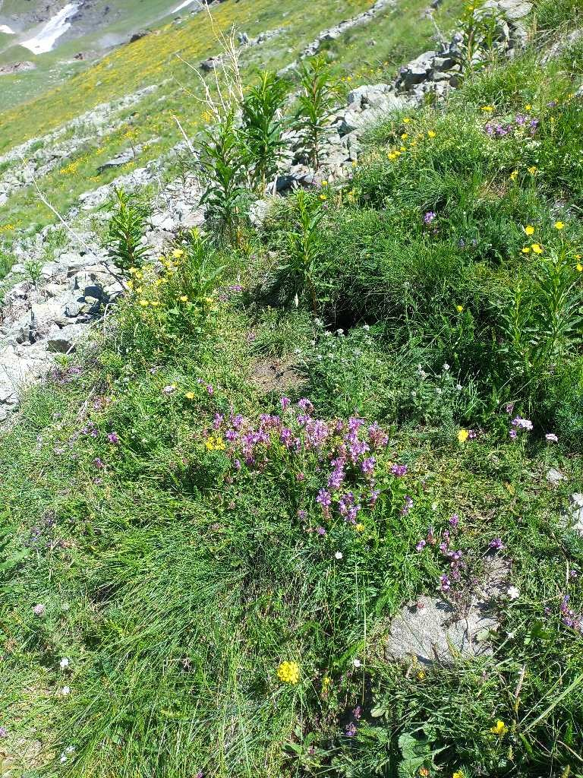
Terriers marmottons 2024
Chalet

Slide 16
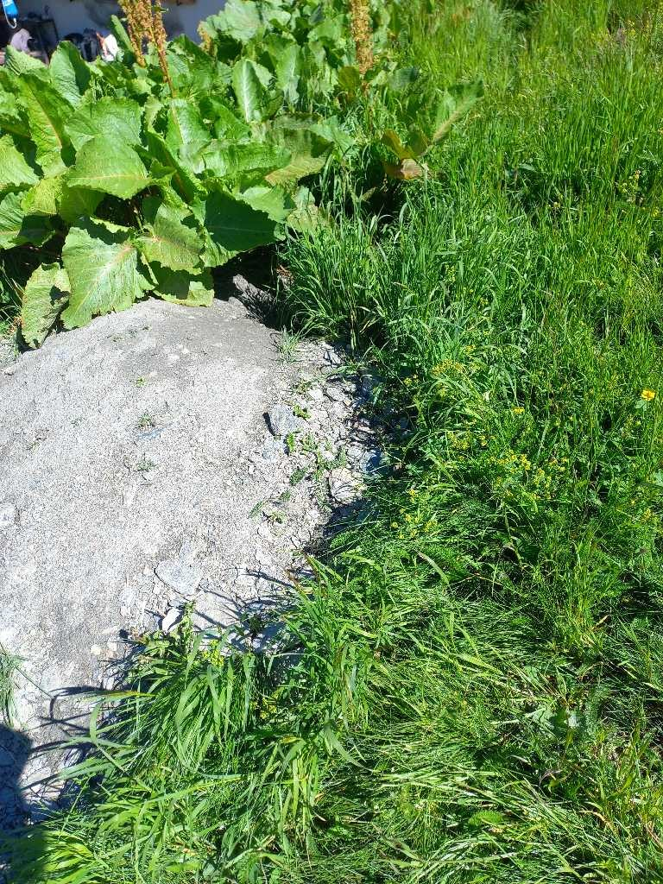
Terriers marmottons 2024
Chalet bas

Slide 17
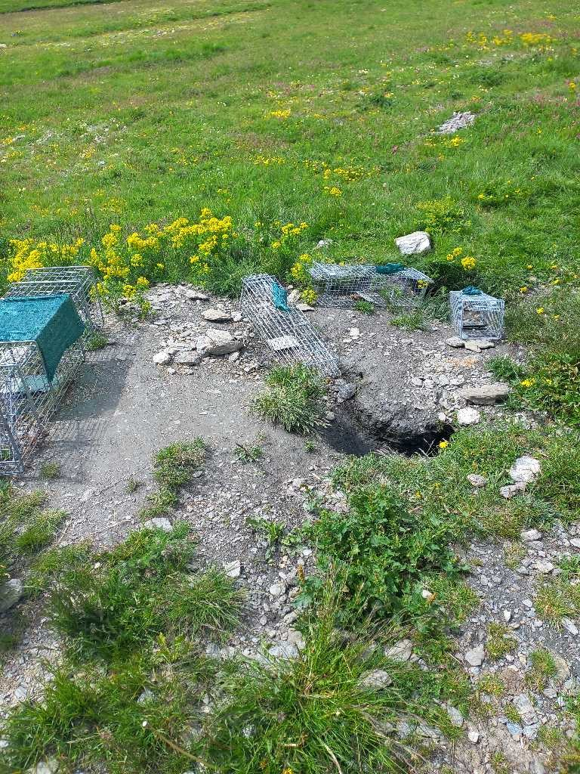
Terriers marmottons 2024
Eadret
(1er terrier)

Slide 18
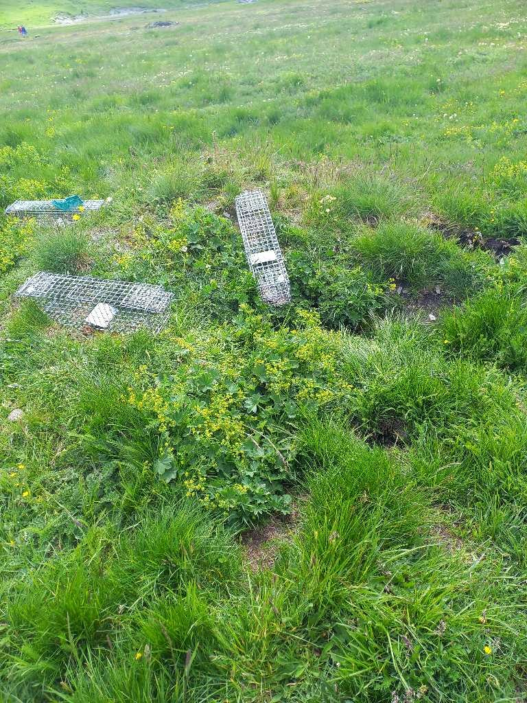
Terriers marmottons 2024
Eadret
(2eme terrier)

Slide 19
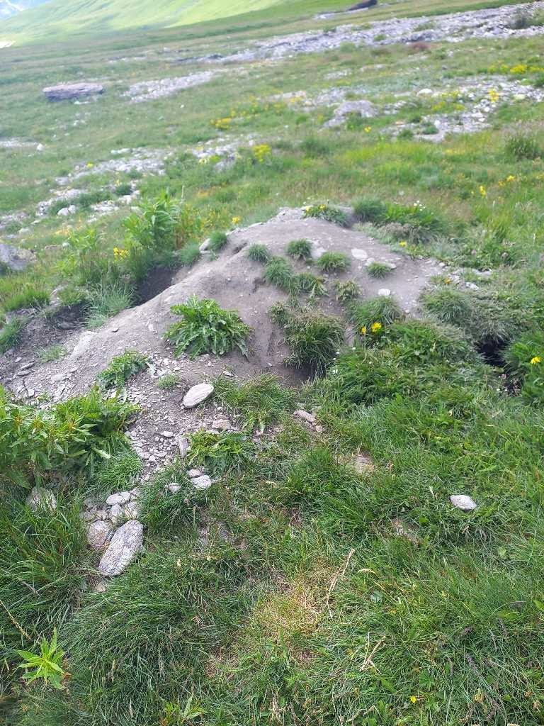
Terriers marmottons 2024
N2

