Slide 1
Of Mountains and Marmots : climate change in the French Alps

Slide 2
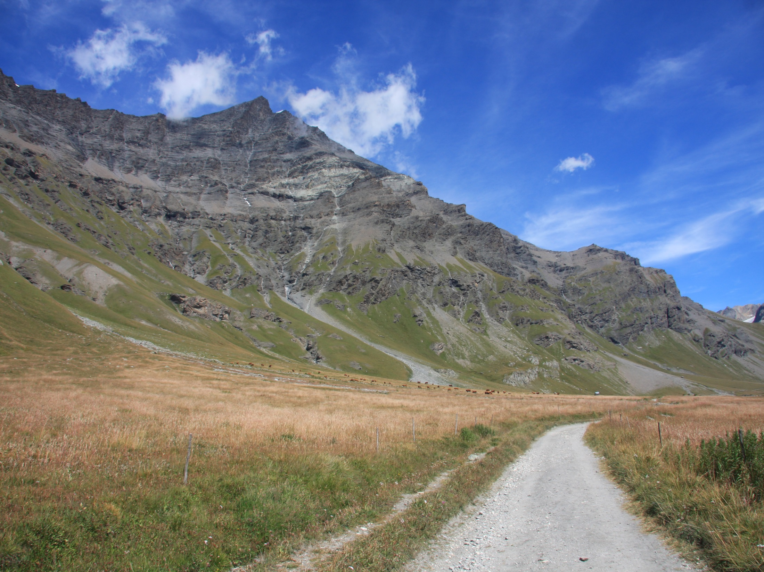
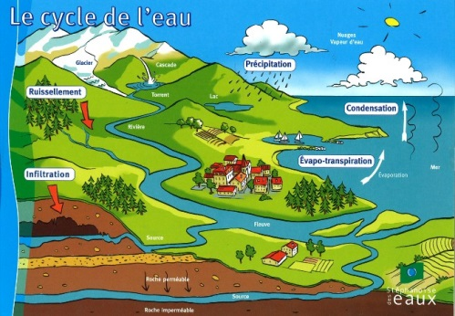
What is climate change?
Changes of climate climate which is attributed directly or indirectly to human activity that alters the composition of the global atmosphere and which is in addition to natural climate variability observed over comparable time periods.

Slide 3
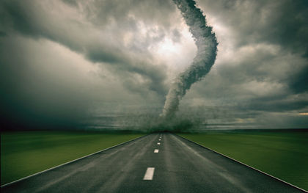
What is climate change?
Changes of climate climate which is attributed directly or indirectly to human activity that alters the composition of the global atmosphere and which is in addition to natural climate variability observed over comparable time periods.

Slide 4
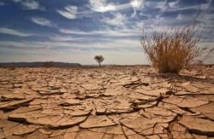
What is climate change?
Changes of climate climate which is attributed directly or indirectly to human activity that alters the composition of the global atmosphere and which is in addition to natural climate variability observed over comparable time periods.

Slide 5
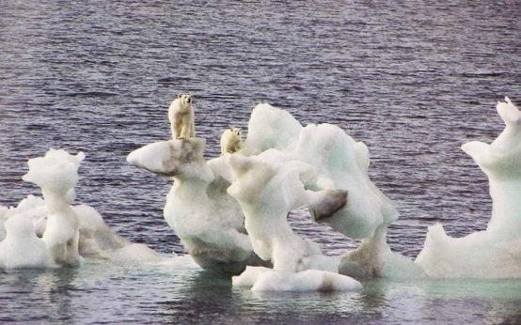
What is climate change?
Changes of climate climate which is attributed directly or indirectly to human activity that alters the composition of the global atmosphere and which is in addition to natural climate variability observed over comparable time periods.

Slide 6
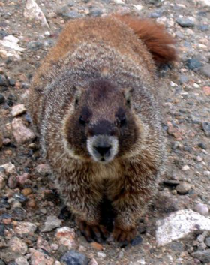
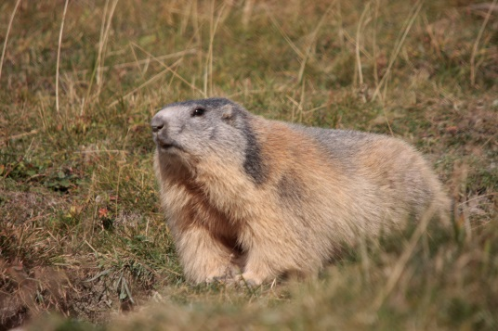
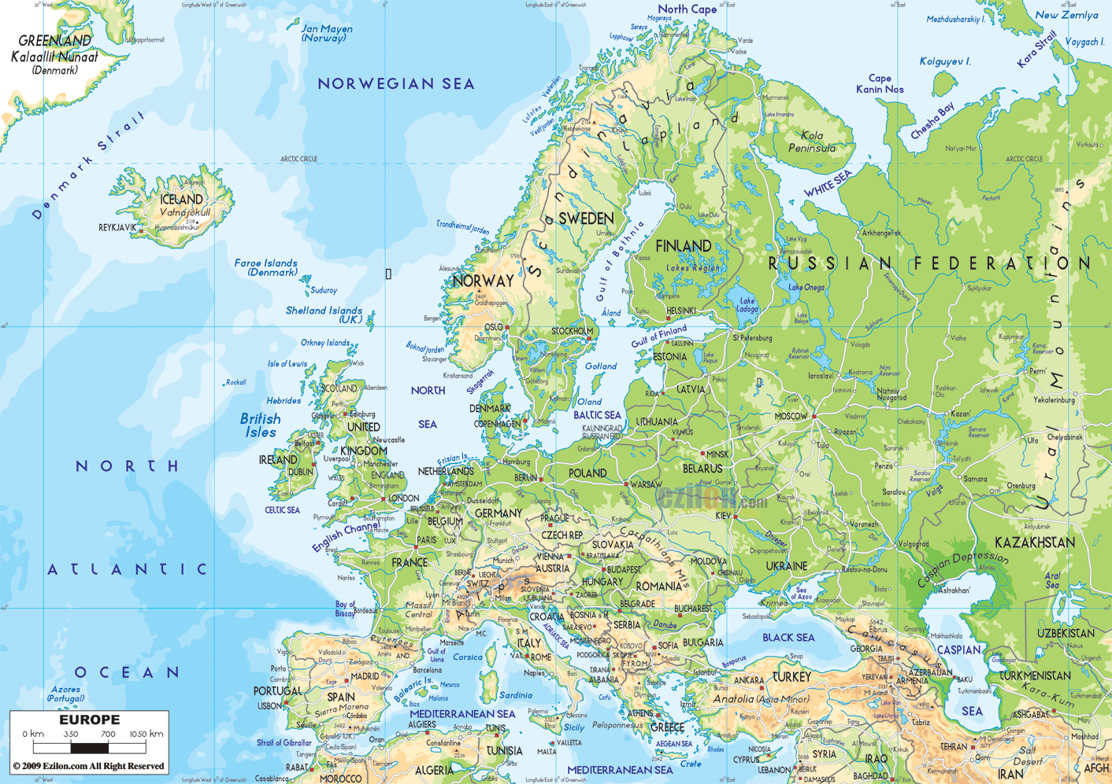
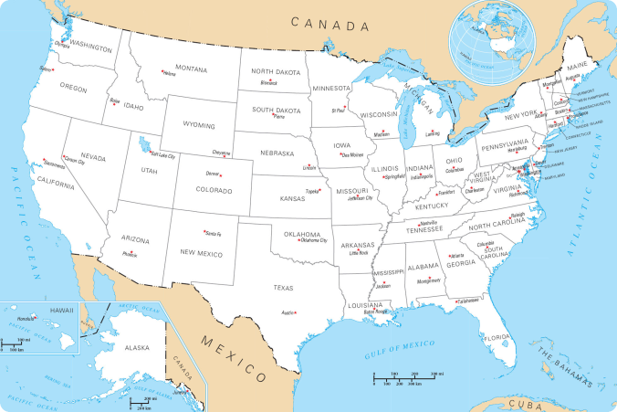
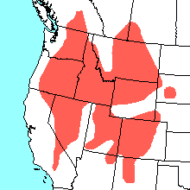
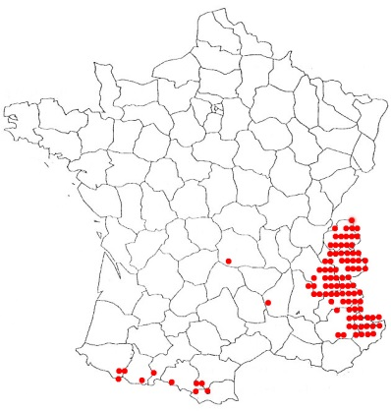
Consequences on Marmot biology?
Yellow-bellied marmot
(Marmota flaviventris)
Alpine marmot
(Marmota marmota)

Slide 7
Consequences on Marmot biology?
Yellow-bellied marmot
(Marmota flaviventris)
Ozgul et al, 2010
Alpine marmot
(Marmota marmota)
Tafani et al, 2013
Climate change = modification on phenology

Slide 8
Consequences on Marmot biology?
Yellow-bellied marmot
(Marmota flaviventris)
Ozgul et al, 2010
Alpine marmot
(Marmota marmota)
Tafani et al, 2013
Climate change = modification on phenology
Emerging earlier
Giving birth earlier = more time to grow between emergence and hibernation
Increase of body mass for all age classes
Better survive and reproduction
Population growth

Slide 9
Consequences on Marmot biology?
Yellow-bellied marmot
(Marmota flaviventris)
Ozgul et al, 2010
Alpine marmot
(Marmota marmota)
Tafani et al, 2013
Climate change = modification on phenology
Emerging earlier
Giving birth earlier = more time to grow between emergence and hibernation
Increase of body mass for all age classes
Better survive and reproduction
Population growth
Decrease of winter snow cover
Over-consumption of marmots fat reserve during hibernation
Skinier female
Less pups produce
Population growth

Slide 10
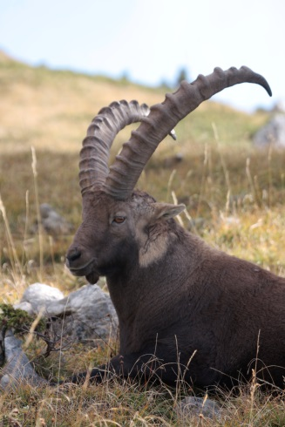
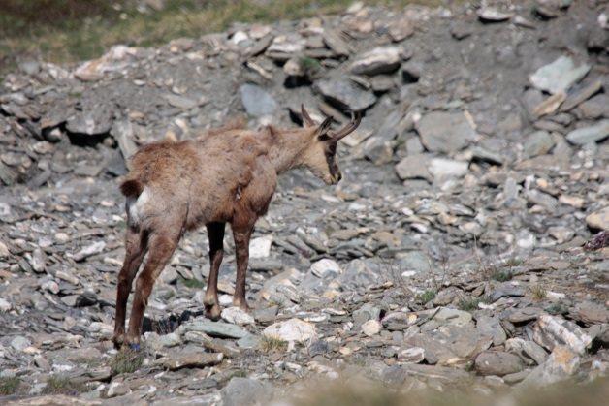
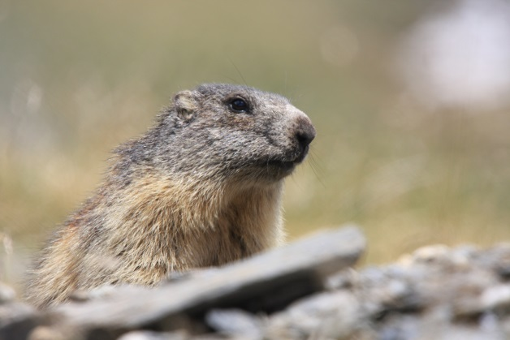
Why are the French Alps a good ecosystem to study climate change?
Alpine ecosystems extremely sensitive to disruption
Species extremely adapted to environmental conditions
Confined to extreme habitats and can’t migrate
Respond rapidly to climate change

Slide 11
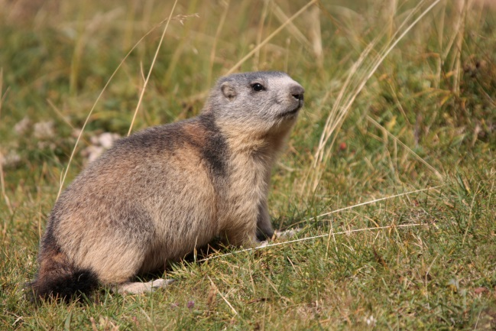
Marmots monitoring :
= Good subject for modeling the impact on climate change in alpine fauna
Hibernating species, adapted to Alpine ecosystem
Lives in altitude between 800 and 3000 meters
Complex social structure : single dominant couple, subordinates and pups
Subordinates stay beyond sexual maturity within their natal group, helping parents to raise pups.
Annual activity variable over time, depending on season

Slide 12
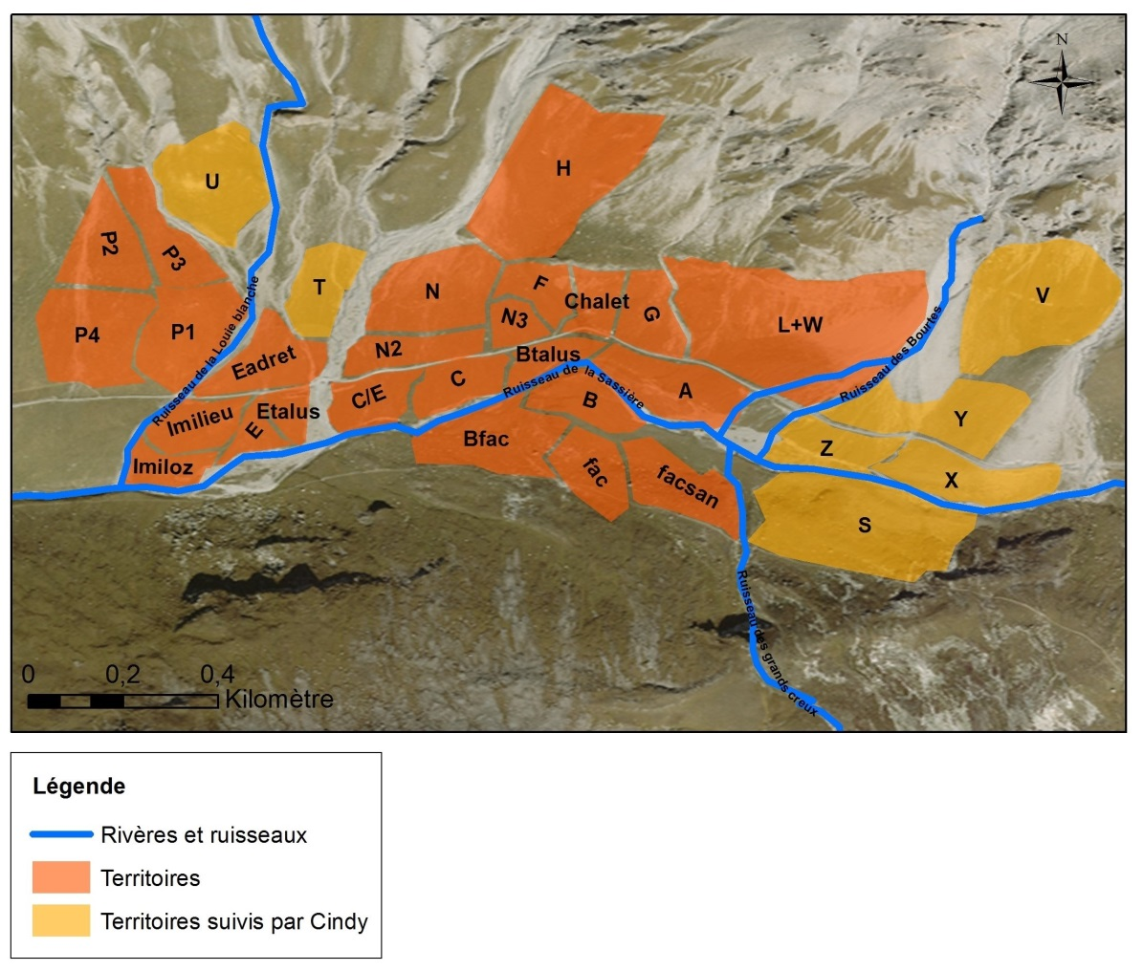
Marmots monitoring :
Since 1990 :
32 marmots families studied
1300 individuals followed

Slide 13
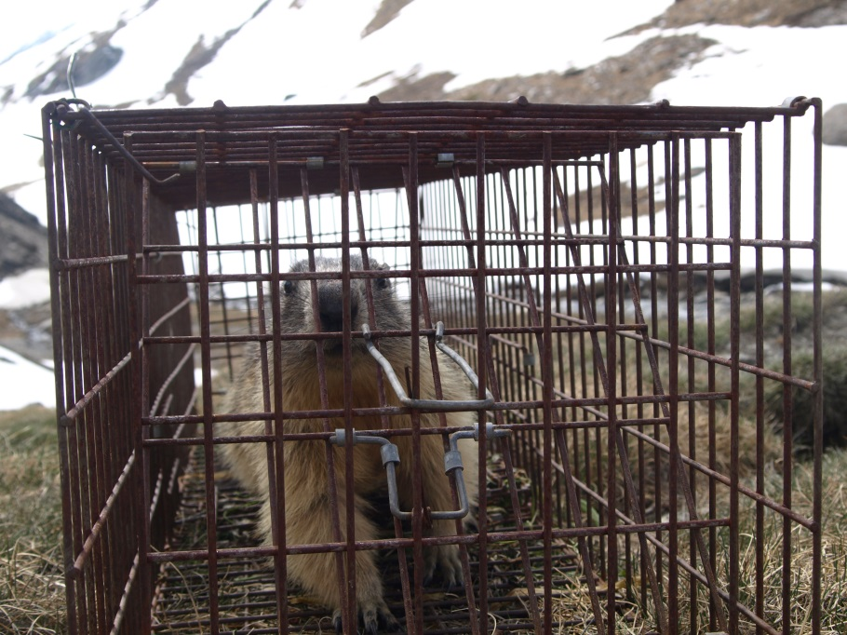
Marmots monitoring : captures
The marmot study, consist in :
Trapping marmots

Slide 14
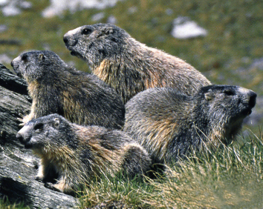
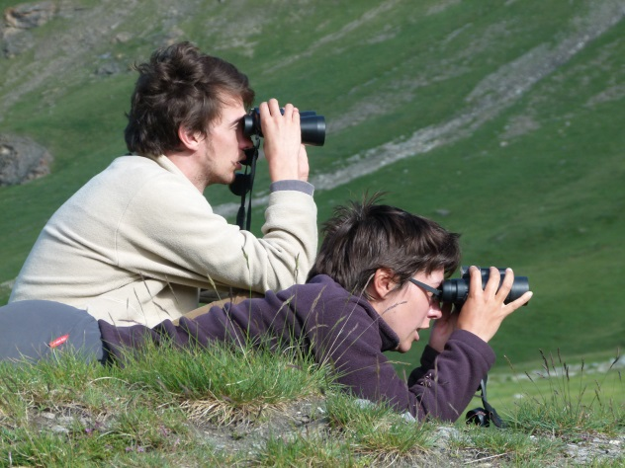
Marmots monitoring : family counting
The marmot study, consist in :
Trapping marmots
Family counting

Slide 15
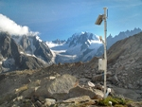
Climate change monitoring in La Sassière
Weather station partly founded by Earthwatch volunteers

Slide 16
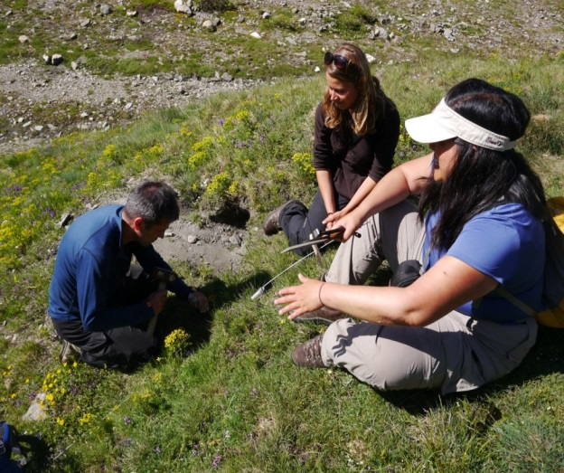
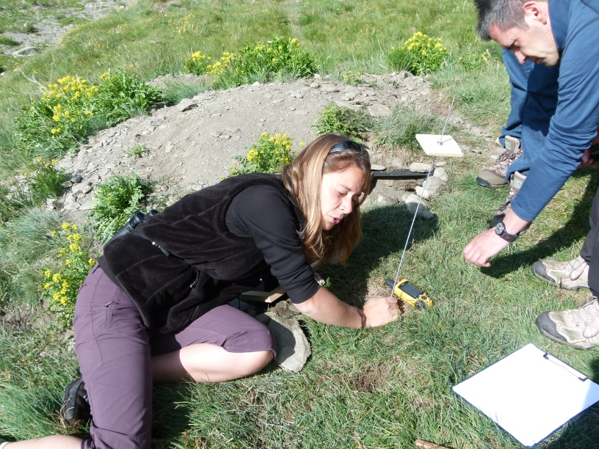
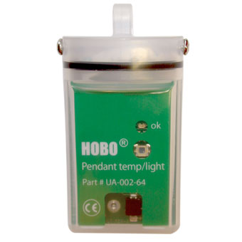
How climate change affects marmots during hibernation?
Monitoring temperatures variations inside burrows

Slide 17
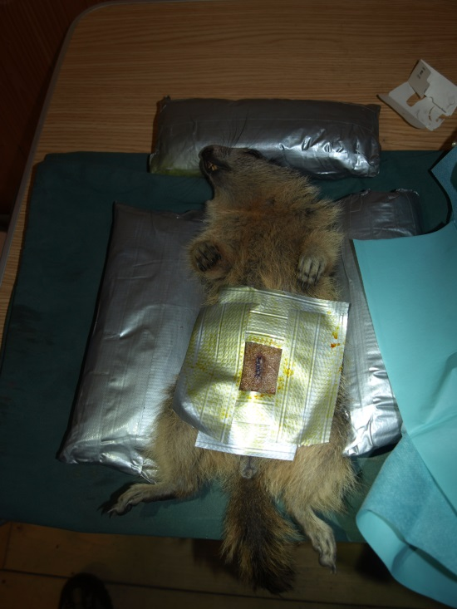
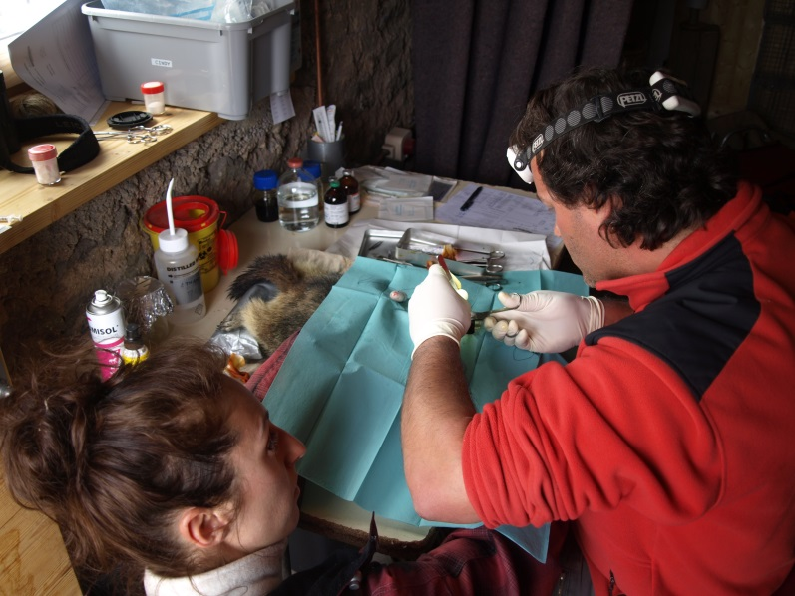
How climate change affects marmots during hibernation?
Monitoring temperatures variations inside marmots
How climate change affects marmot physiology

Slide 18
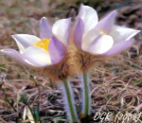
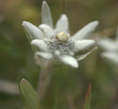
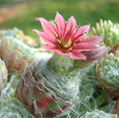
How climate change affects ecosystems and marmots food?
Monitoring plants flowering
Pasque flower
Pulsatilla vernalis
Edelweiss
Leontopodium alpinum
Cobweb Houseleek
Sempervivum arachnoideum

Slide 19
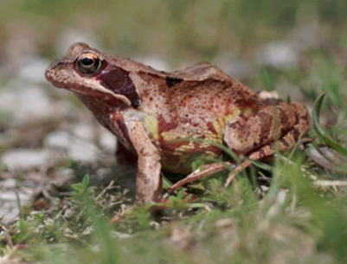
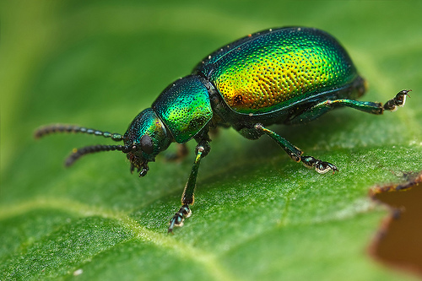
How climate change affects other species life cycle ?
Monitoring frog and beetles reproduction
Grass frog
Rana temporaria
Green dock beetle
Gastrophysa viridula

Slide 20
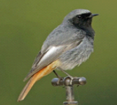
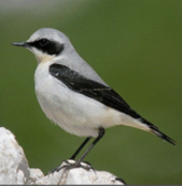
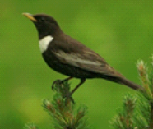
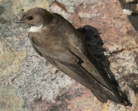
How climate change affects other species?
Monitoring birds migration
Black redstart
Northern weathear
Plastron blackbird
Eurasian crag martin

Slide 21
Other activities
Sociality monitoring : Helpers contribute to pups survival.
How sociality will evolved with climate change?
Reproduction monitoring = Capital parameters in population monitoring
Behavioral observations
Inside activities

Slide 22
More details ?
Refers to :
Field manual
Protocols manual
→ And ask questions

Slide 23
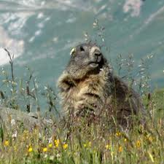
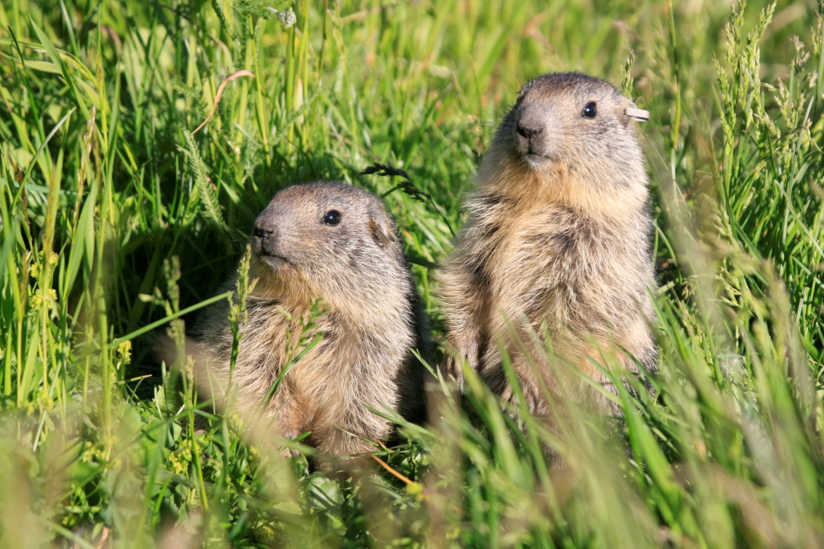
Of Mountains and Marmots: Climate Change in the French Alps
Have fun and enjoy your time with us!
Welcome!

